Slide 1
Carnoostival HQ - Weekly Update – 28 May 18
7 weeks to go!
NEXT
DOING
DONE
Contracts in progress with:
Event clean up (AC waste management)
Contracts in progress with:
Safe-Tay Security firm
Audio Wave Stage/lighting/audio firm
Burnside first aid
Bernicia Suite
Contracts agreed with:
Gleadhraich / Booker / Funk & Disorderly/Just 3 Folk/ Ronald Simone Swing Trio/Salsa Celtica/Abandon
Son of the Sea
Bespoke Bar Company
Angus Farmers Market
W C in Fields toliets
Zones in progress with:
- tbc
Compliance:
First aid
Police Scotland
Meet with local parks manager
Zones in progress with:
East Scryne – Farm Zone
Various – Beauty Zone
Fiona Forbes – Dance displays
Medieval reenactment ???
Outdoor cinema screening – blue monkey
Carnoustie micro businesses – local stalls
Donkey Bond – Balnuith Farm
Highland Fling – Titanic
Digger exhibit – D J Laing
Zones agreed with:
Caledonia Fitness – Fit Zone
Angus Alive – Golf Zone
Community First – Kids Zone
Marketing:
Festival site branding:
Banners
Flags
Zones
Entrance
Walkway from Dundee st
Registration campaign
Volunteers campaign
PR to promote the acts & zones
Compliance:
Public Liability Insurance done
Entertainment application submitted
Public notice 21 days on House Grounds
Park let application done
Compliance:
Traffic, Cars & Risk Management
Marketing:
Carnoostival merchandise
Carnoostival volunteer packs
Marketing:
Maiin acts announced
Design for maps & postcards
Carnoostival chosen name
Carnoostival HQ = 26 High St
Ordered signage for High St
Volunteers:
Keeping volunteers engaged and motivated
Volunteers to monitor & respond to twitter #askcarnoustie
Volunteers:
2 onboard looking for 3 more this week
25 more for week of Open
Films:
7 x people shorts in progress
1x Carnoustie Film in progress
Volunteers:
Business Angus voluteers CS training
Community First managing volunteers
Films:
Secure Dylan for 21 July
Logistics to screen live filming at event
Others:
Dibble Tree Theatre Talent Context
Open Mic slots at main stage
CCDT merchandising stall
Open POS pack for traders expected next week at Carnoostival HQ
Films:
Bethany/Priya/Libby Carnoustie Shorts
Others:
Agreement pending for hanging baskets (Colourful Carnoustie/AC/R&A)
Others:
Art Competition live
Rodger to compare Carnoostival
Bunting for Community Council arrived

Slide 2


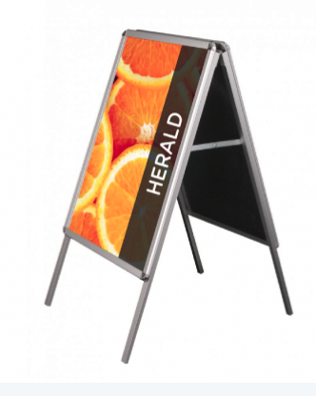

Coming this week outside Carnoostival HQ
26 High St
Pavement A Sign
Feather Flag 2.8mtrs

